Slide 1

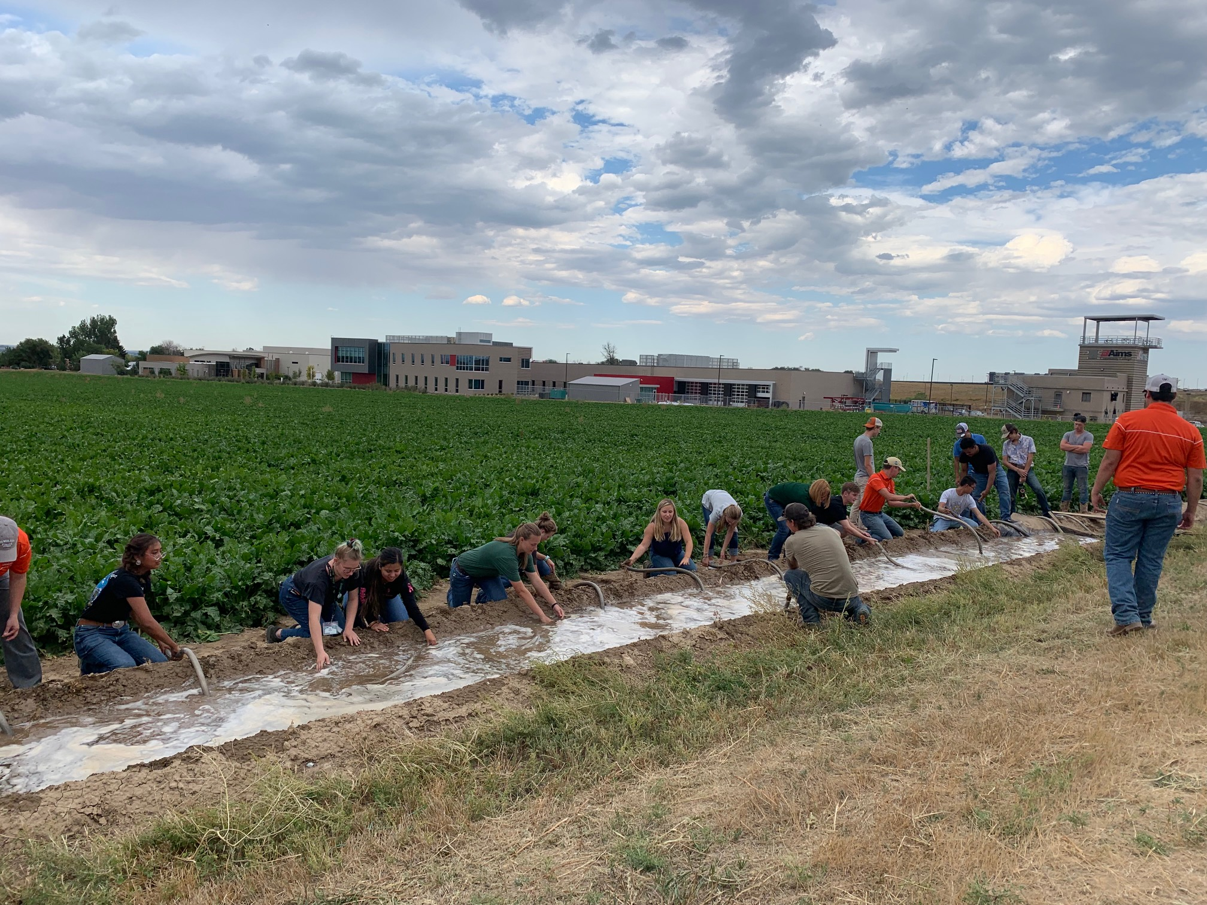
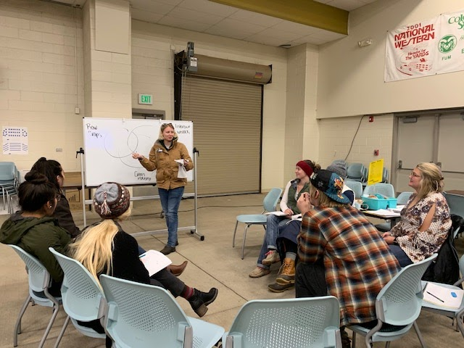
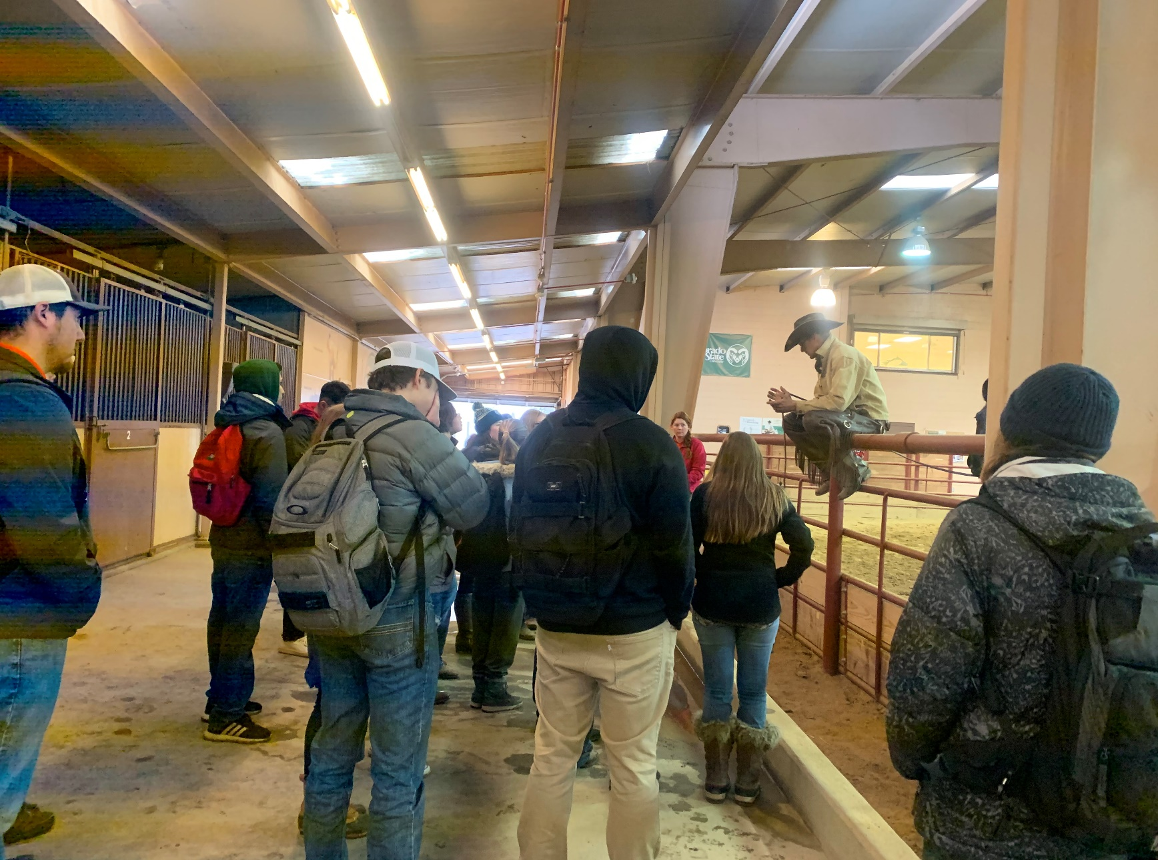
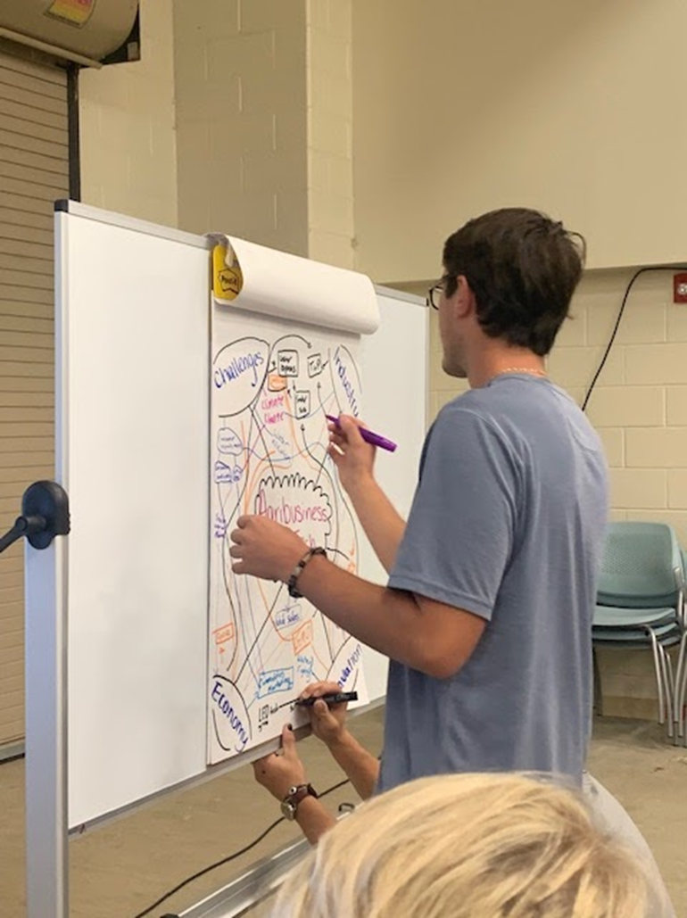

Utilizing High Impact Practices to
Improve First-Year College Experiences
Jenny Bennett & Kellie Enns
Introduction/Purpose of the Study
Nearly two-thirds of incoming students at Colorado State University, College of Agricultural Sciences (CAS) do not come from an agricultural background (Jeracki, 2019) and recent data from Institutional Research, Planning, and Effectiveness (2018, p.53) show that the CAS falls below the University average for first-year retention.
First Year College Experiences Class
Contemporary Agriculture Systems, a first-year experiences course, utilized High Impact Practices (HIPs) (Kuh, 2008) to achieve the following goals: improved agricultural literacy through experiences across a diverse agriculture industry in Colorado, and sense of community between students, student mentors from CAS, industry leaders, and CAS faculty. Three HIPs were implemented: the first-year experience, multi-faceted collaboration, and intensive writing. Students participated in an agriculture field experience, and the next week a class debrief where they met in small cohort groups to participate in a discussion and reinforcement activities. These agricultural experiences varied from farm tours, to processing facilities, CSU Experiment Station (ARDEC), and local grocery stores and farmers markets. Debriefs took place in a large classroom with flexible seating to allow for a more collaborative classroom environment.
Methods
Following each experience, students responded to a reflective writing prompt. Utilizing the broad goals of the course, the team read through the reflections allowing the student responses to inform the researcher’s views of the themes surrounding the course goals. Standards of rigor were followed for this research including triangulation, member checks, and conducting an external audit with course participants (Creswell, 2005).
Results/Themes
Theme 1:
HIPs facilitated an understanding of a broader agriculture system
Theme 2:
HIPs facilitated deeper learning and connection building
Theme 3:
HIPs allowed for students to develop and express pride in the institution
“While visiting the Schwalm’s Farm, myself and many other of my peers were exposed to a lifestyle that the average person is not connected within their everyday schedules. This was a great way for all of us students to broaden our knowledge in the agricultural field (literally).”
“It seems so obvious that this food doesn’t just pop up out of nowhere…People just don’t seem to make that connection and I felt that was a very vital experience for me. It really changed my entire thought process on everything I eat.”
“…our discussions [were] much more valuable than they would have been one large group. The group leaders were also great at getting me to think deeper and make connections between experiences I wouldn't have made otherwise."
“I’m taking AREC 202…microeconomics, and in that class we are learning about demand and price elasticity. Being able to tie this example into the class is on from real life experiences is something that is hard to forget…I may forget an equation, but being able to learn hands on from real life experiences is something that is hard to forget.”
“I didn't even know that CSU offered a lot of the things that they showed us…For example, the program for students to help rehabilitate the animals through interacting with them and caring for them…also for students to train their horses and prep them for sale at the end of the year.”
Conclusions/Recommendations
Analysis of student reflections from the three years of this course, it is evident that the HIPs utilized expanded knowledge of agriculture and sense of community. There is the potential for a positive effect on student retention within the college, and further research should be conducted to see if students in the three cohorts have been retained. In the voice of a student participant: “All around, it was a very valuable experience, and I would 100% do it again. The information that I did gain was very fascinating and allowed me to get one step closer to having the knowledge of the students around me that spent their whole lives around agriculture.”
References
See poster abstract for full reference citations

