Slide 1


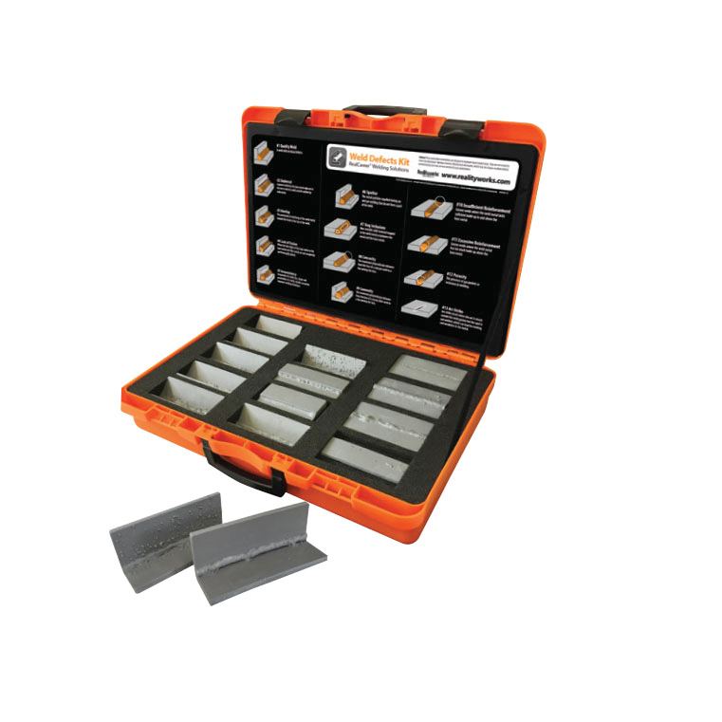


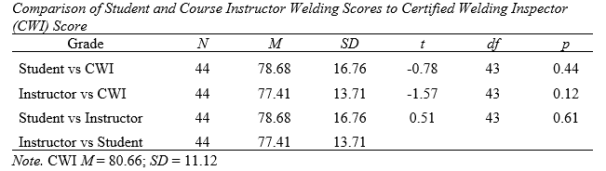


Using Triangulation Scoring to Improve Student Evaluations
Rhett A. Sykora, Ryan G. Anderson, Marshall Swafford, Bradley D. Borges
Texas State University & Arkansas Tech University
Steps | Activity | Description
Step 1 | Welding quality | Students receive technical knowledge from the course instructor relating to weld quality.
Step 2 | Demonstration | The instructor provides a demonstration of an acceptable weld.
Step 3 | Practice welding | Students practice welding, receiving feedback from the instructor.
Step 4 | Test week | Students practice welding, receiving feedback from the instructor and the CWI, submitting their highest quality weld for grading
Step 5 | Self-assessment | Students assess their welds.
Step 6 | Instructor assessment | The course instructor independently evaluates the students’ welds.
Step 7 | CWI assessment | The CWI independently evaluates the students’ welds.
Step 8 | Triangulation of evaluation | Students receive the feedback from the course instructor and the CWI.
Introduction
The welding process is crucial to agricultural mechanics an requires effective corrective feedback in the learning process to achieve the adequate skills necessary to perform quality welds (Stone et al., 2011a; Abrams et al., 1974).
Previous methods of welding evaluation sought feedback from the instructor or a certified welding inspector (CWI) but had no formal attempt to include the student.
Ghaincha (2016) noted that self-assessment can prove beneficial to further develop effective educational curriculum and increase learning outcomes.
In order to include the students’ self-evaluation, the instructor evaluation, and the CWI evaluation, we developed the triangulation of welding evaluations.
Student Evaluation
Instructor evaluation
CWI evaluation
Costs associated
Costs associated with this project were minimal to our department.
If an instructor elects to include welding defect posters, they can request those free of charge from Miller Welding and Lincoln Electric or purchased for $59 through Realityworks.
The Weld defect Flashcards can be purchased for $179 and the weld defect classroom kit can be purchased for $999 through Realityworks

