Slide 1

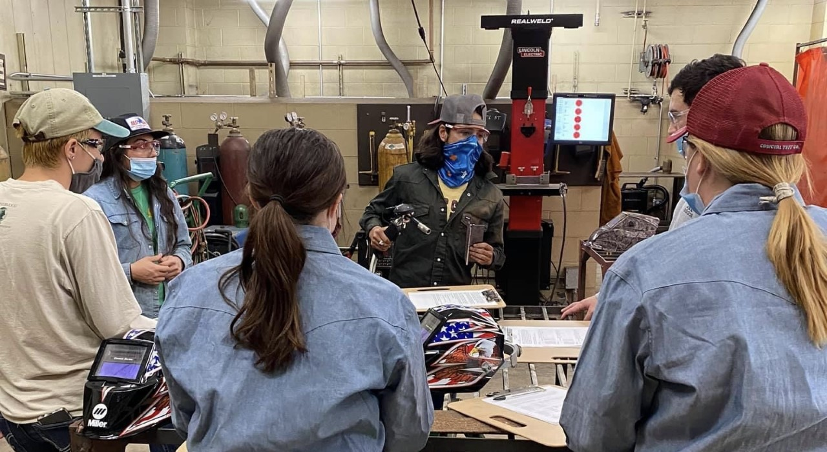
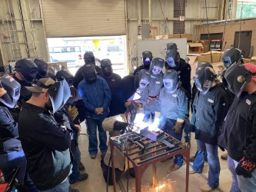
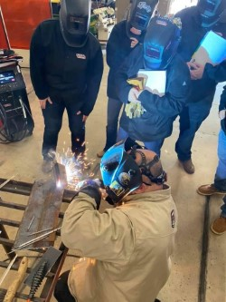
Developing Industry Partnerships to Provide Welding Certifications
Template for a 48”x36” poster
Presenter name, Associates and Collaborators
Department of XXXXXXXXXXXXXXXX, College of XXXXXXXXXXXXXXXXXX, University of Illinois at Urbana-Champaign
Jacob D. Ramos, Dr. Ryan G. Anderson, and Bradley D. Borges
Department of Agricultural Sciences, College of Applied Arts, Texas State University
Introduction
Agricultural mechanics knowledge and skills, such as welding certificates, can be improved through professional development opportunities in undergraduate welding courses.
Through agricultural mechanics courses, students can begin or further their welding skill development and even earn welding certificates
How It Works
Students enrolled in the Introduction to Agricultural Engineering course learn and apply concepts from the welding trade throughout four weeks of their academic semester
A welding educator and CWI educate students on industry standard welds during the welding training
Students who provide a quality, passing weld earn a welding certificate from the CWI
Students are exposed to internship and career opportunities through these partnerships.
Students are introduced to welding trade during lab sessions
Students train with industry partners
Internship and career opportunities for students
Cost and Resources Needed
The local industry partner donated their time to assist with this project resulting in no additional cost for the implementation of this idea.
Future Plans/Advice to Others
Many students are on the path to becoming welding educators or working within the industry, making partnering with local welding companies an important asset for future success.
School-based agricultural education, welding, and agricultural mechanics educators are encouraged to foster partnerships with industry CWIs and instructors early in their careers to help improve quality of welding instruction in their classrooms.

