Slide 1

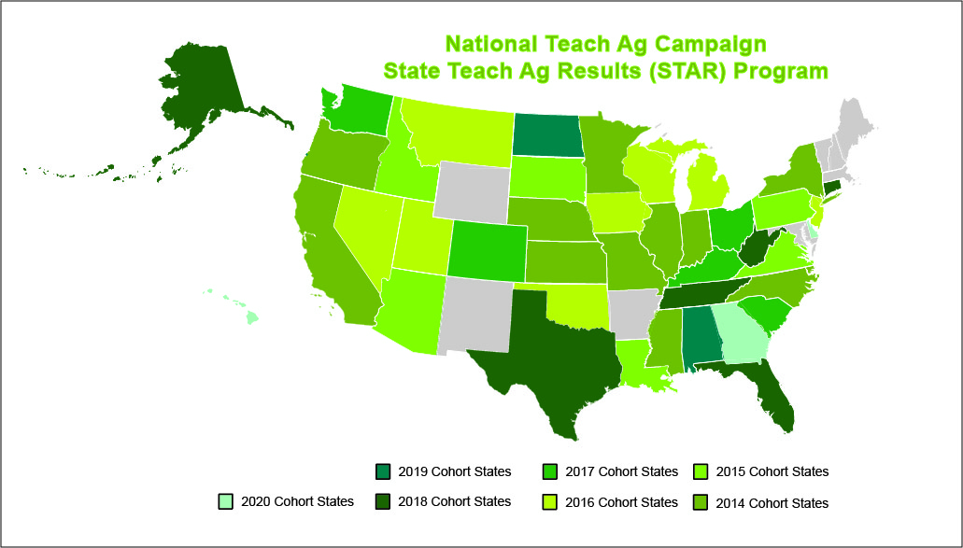

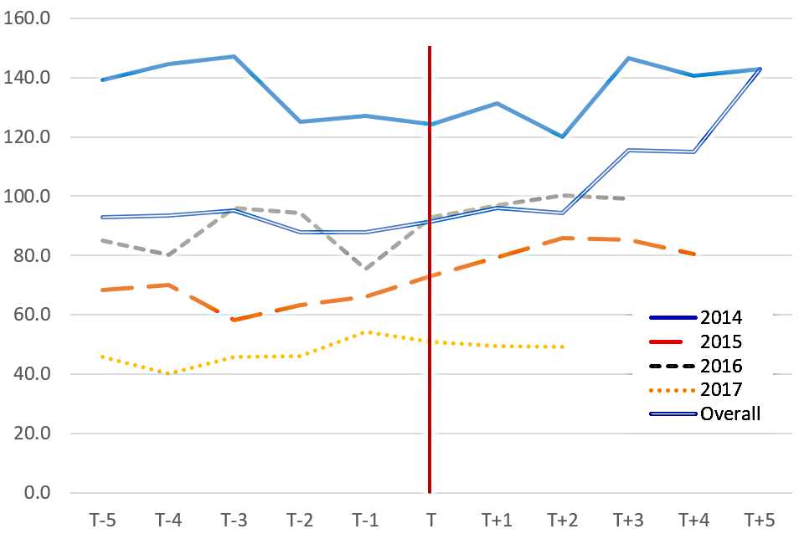


Relationship between Enrollments in Land-Grant Agricultural Education Majors by Year and State Participation in the Teach Ag STAR Program
Rachelle Andreatta (North Carolina State University), Ellen Poeschl (NAAE), Travis Park (NC State)
Introduction
Methodology
Conclusions
Ag ed has suffered a shortage of teachers for decades (Eck & Edwards, 2019)
In less than a decade, 1,632 new agriculture teacher positions were created.
To recruit ag teachers, National Council initiated the Teach Ag program in 2009.
This research purpose was to determine the Teach Ag STAR effectiveness on enrollments in agricultural education in colleges of agriculture (COA).
Data derived from Teach Ag STAR participation data and land-grant agricultural education enrollment data collected from the Food and Agricultural Education Information System (FAEIS) at Virginia Polytechnic State University (2021).
Enrollment data were collected from COA from 2002 through 2019 and from STAR states between 2014 and 2019.
STAR data was omitted from analyses for four states due to FAEIS reporting irregularities; states included FL, IL, ND, TX.
Data yields enrollments from five years prior to participation in STAR compared with five years after the state began STAR or until 2019.
There is a positive relationship between STAR program and student enrollment in agricultural education at land-grant universities.
While it is suggested that STAR has a positive influence on enrollment, it is not suggested that STAR is the only extrinsic factor influencing enrollment.
Recommendations
Further analysis should be done of the programs implemented in STAR states with successful enrollment.
This could potentially improve the enrollment rates if identified and implemented in all states.
Encouraging more states to become STAR states may increase enrollment and help close the gap of agricultural educators needed nationwide.
Results/Findings
Land-grant institutions in 12 states experienced their highest enrollment since 2002 after STAR.
Land-grant institutions in 17 states increased enrollment since STAR began in their state.
Of the 2014 cohort of STAR states, which had full range of longitudinal data, 8 showed an increase of 149 students in the 5 years once STAR was initiated in the state.
Theoretical Framework
References
Ag Ed FIT-Choice® model (Lawver, 2009; Richardson & Watt, 2006) explains the perspective and intent to pursue a career.
4 constructs: task return, self-perception, intrinsic career value, and fallback career (Lawver, 2009).
Teach Ag STAR attempts to influence task return and intrinsic career value, focusing on personal utility value.
Eck, C. J., & Edwards, M. C. (2019). Teacher shortage in school-based, agricultural education (sbae): A historical review. Journal of Agricultural Education, 60(4), 223-239. https://doi.org/10.5032/jae.2019.04223
Food and Agricultural Education Information System (FAEIS). (September 26, 2021). Food and agricultural education information system. Virginia Polytechnic Institute and State University. http://faeis.cals.vt.edu/index.php/data-center
Foster, D. D., Lawver, R. G., & Smith, A. R., (2020). National Agricultural Education Supply and Demand Study, 2019 Executive Summary. http://aaaeonline.org/Resources/Documents/NSD2019Summary.pdf
Kantrovich, A. J. (2010). A national study of the supply and demand for teachers of agricultural education from 2006–2009. West Olive, MI: Michigan State University Extension. https://www.naae.org/teachag/supplyanddemand.cfm#sd
Richardson, P. W., & Watt, H. M. G. (2006). Who chooses teaching and why? Profiling characteristics and motivations across three Australian universities. Asia-Pacific Journal of Teacher Education, 34(1), 27-56. https://doi.org/10.1080/13598660500480290
Smith, A. R., Lawver, R. G., & Foster, D. D. (2019). National Agricultural Education Supply and Demand Study. 2018 Executive Summary. http://aaaeonline.org/resources/Documents/NSD2018%20Summary%20(1).pdf
Woodlin, R. J. (1967). Shortage spurs recruitment efforts. The Agricultural Education Magazine, 40(1), 10-11. https://www.naae.org/profdevelopment/magazine/archive_issues/index.cfm
Figure 1
Enrollment in Agricultural Education at Land-Grant Universities, Standardized to 5 Years Prior to and 5 Years after STAR (N = 23), by STAR Year Cohort (T = 1st year of STAR).

